Slide 1
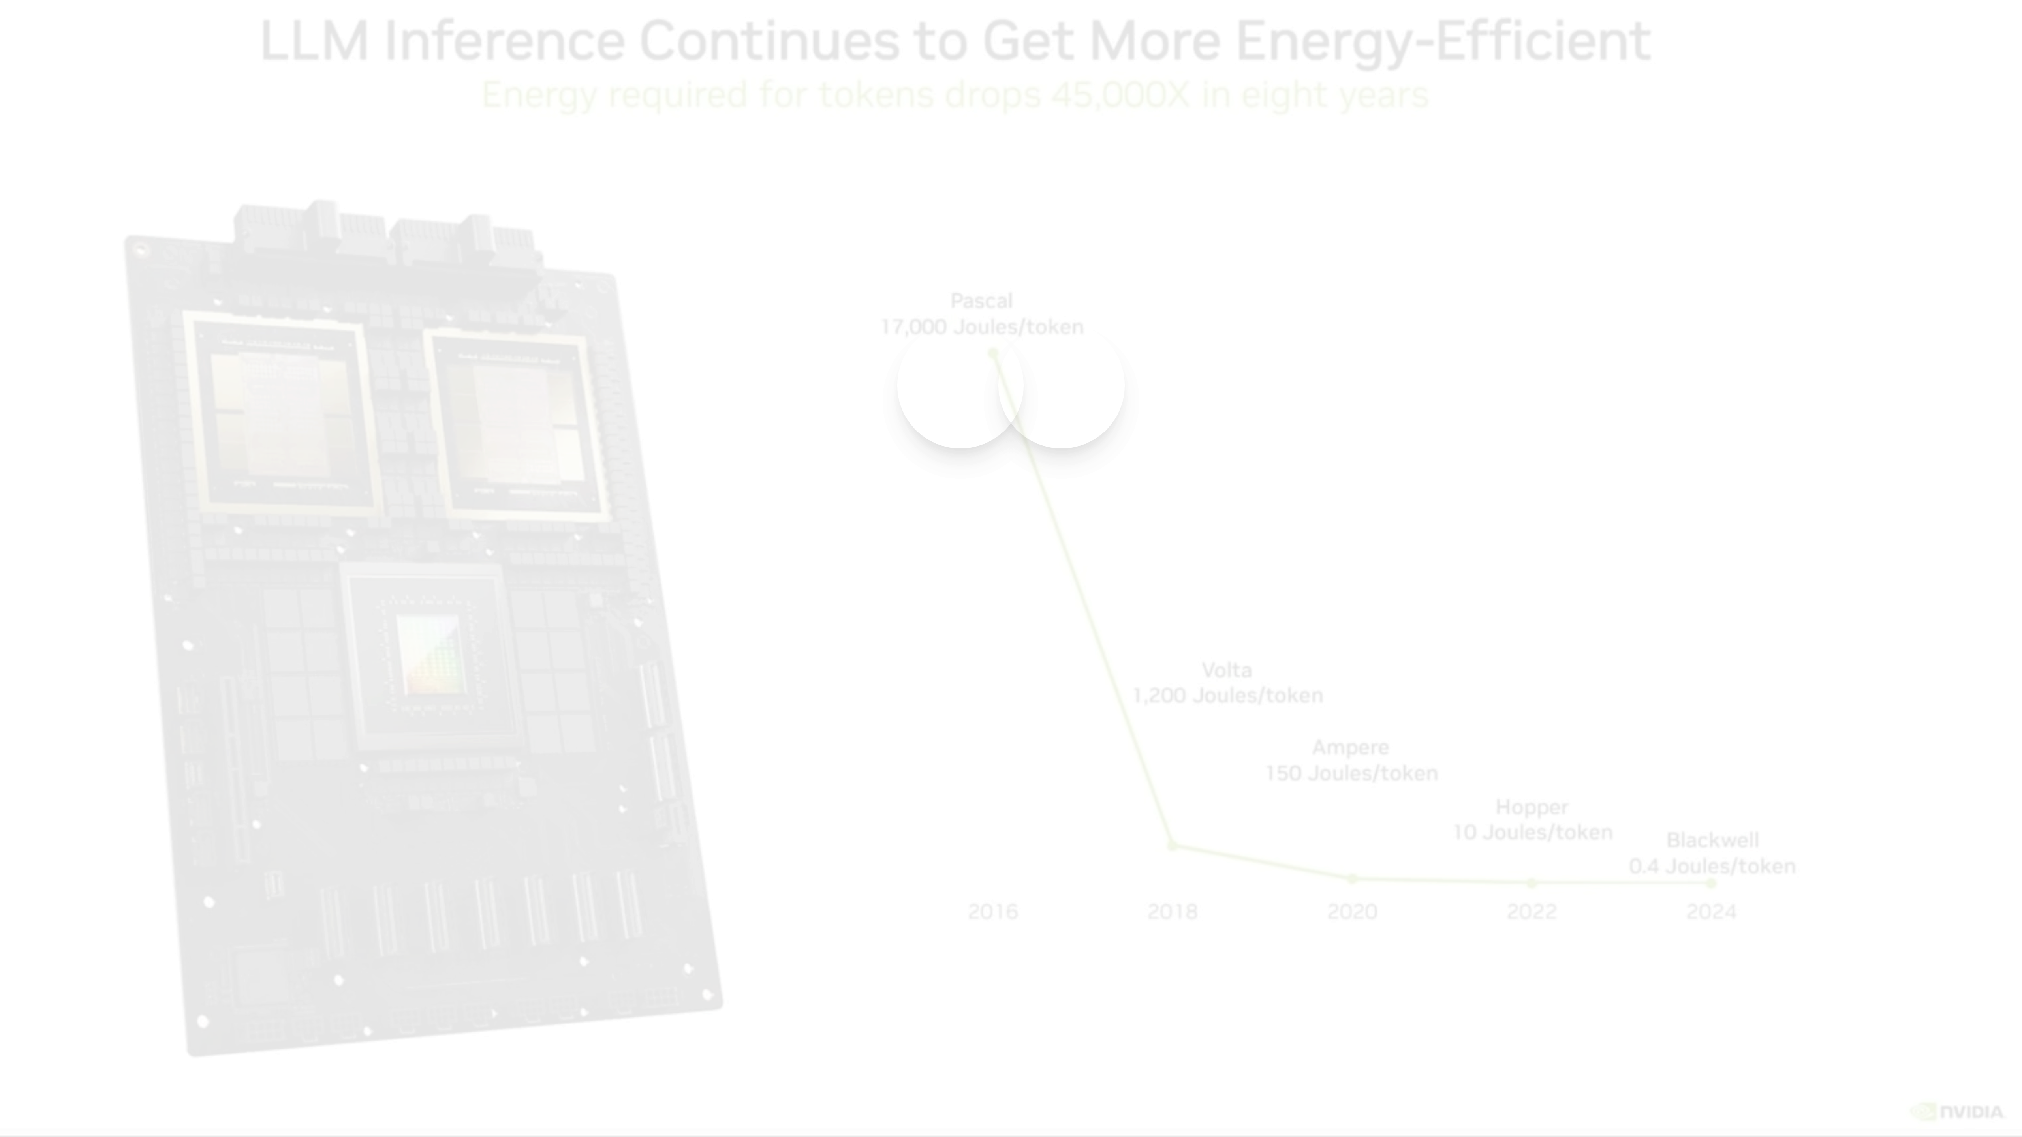


Towards Energy-Aware AI Deployment
Investigating the Interplay of Model Quantization and Hardware Platforms
Presenters:
Course:
Renyuan Lu, Zinan Wang, Haoji Bian
CE 495 Energy-Aware Intelligence (EAI)

Slide 2
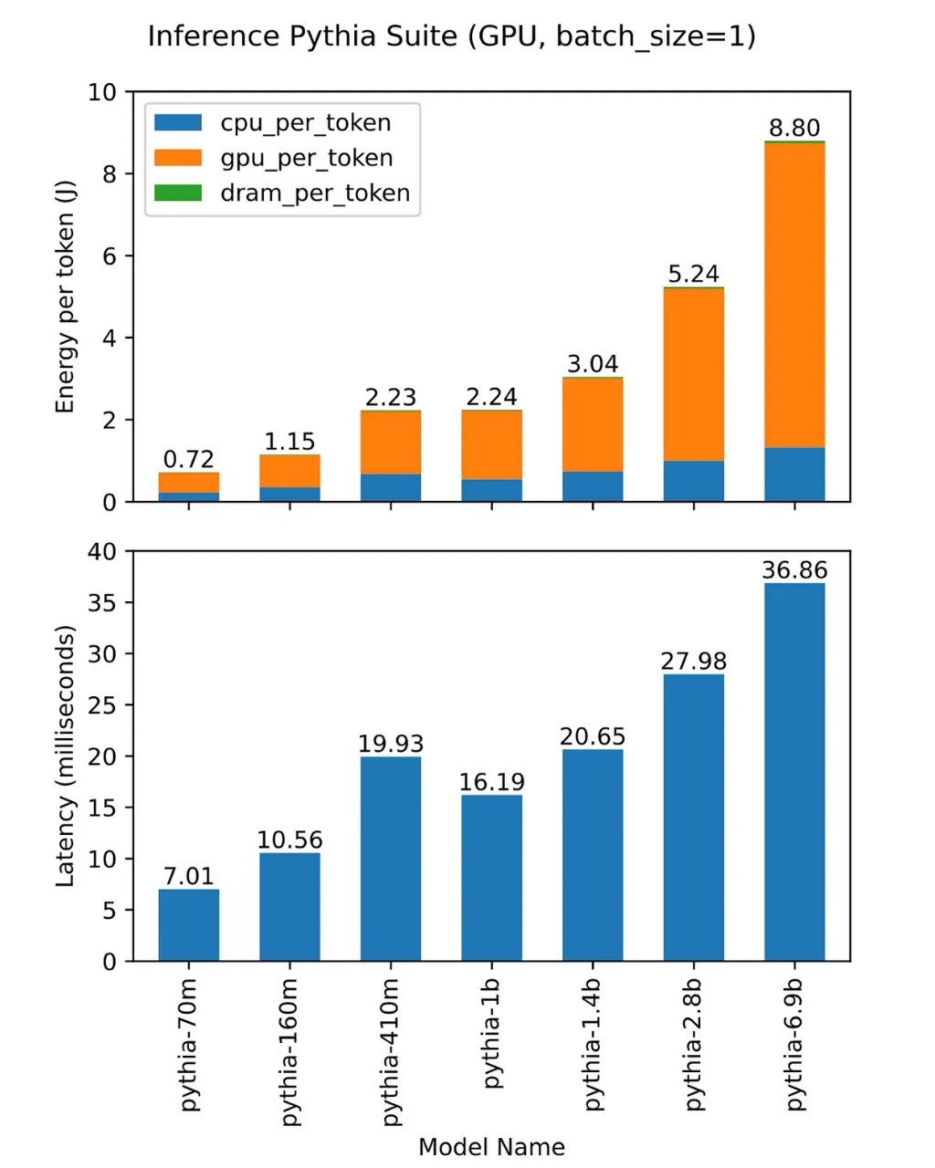
Energy Challenge & Research Motivation
LLM Energy Consumption
Research Motivation
Core Question:
How can we achieve energy-efficient LLM deployment through the synergy of
quantization techniques
and
hardware optimization
?
Research Gap:
Existing research primarily focuses on individual factors, lacking a
systematic co-optimization framework
.
Significance
Environmental Impact:
Reducing energy consumption of AI systems is crucial for sustainable technology development.
Training Large Transformer
High-Frequency Inference
1,287,000
25-40%
Practical Value:
Organizations can achieve significant cost savings while maintaining model performance.
kWh
Energy Optimization Potential
1/10 · Energy-Aware AI Deployment

Slide 3
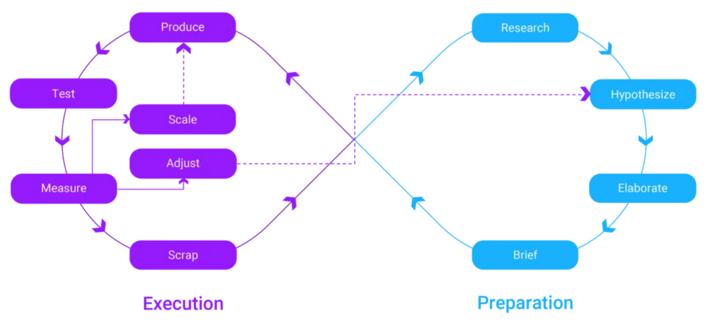



Methodology: Experimental Framework
Experimental Design Highlights
Systematic assessment of quantization impact on energy efficiency
Analysis of hardware architecture characteristics and energy consumption
Novel metrics capturing complex trade-off relationships
Validation of synergistic optimization multiplier effect
Quantization Strategy Evaluation
Hardware Platform Analysis
Novel Efficiency Metrics
INT8, FP16 mixed precision, dynamic quantization
Energy efficiency across 6 GPU platforms
EOR = Task Performance Score / Energy Consumption (Wh)
6 models with 7B parameters
A100 PCIE, RTX 4090, V100, etc.
5 benchmark tasks: MMLU, ARC, TruthfulQA, GSM8K, HellaSwag
Spanning Volta to Ada Lovelace architectures
TWEOR = Task Performance / (Energy × Inference Time)
Real-time power monitoring at 1Hz sampling
3/10 · Energy-Aware AI Deployment

Slide 4
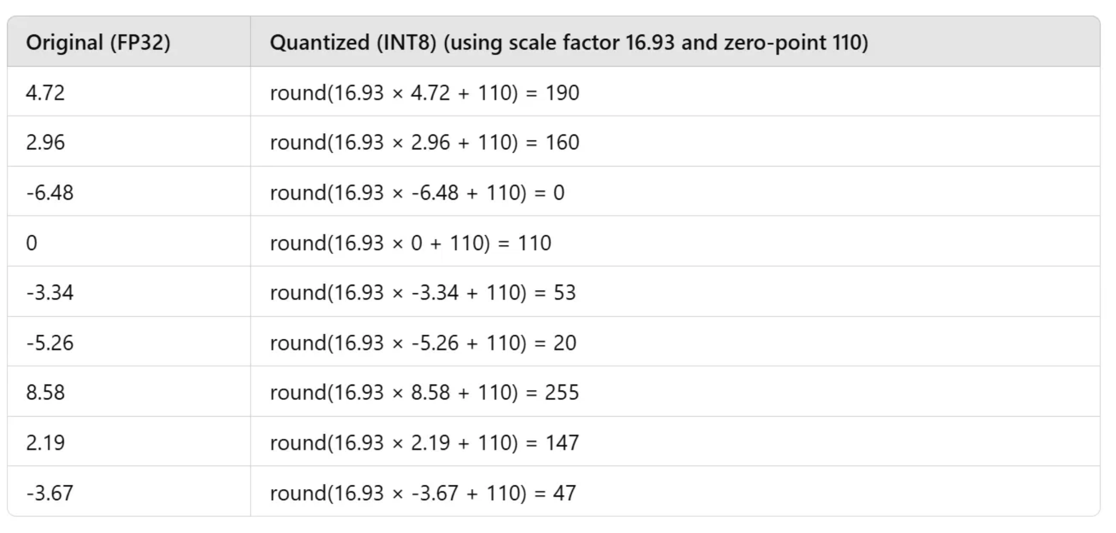
Quantization Strategy Evaluation
Quantization Strategy Comparison
Key Findings
INT8 Quantization Shows Strongest Impact:
25% energy reduction
with only 0.7-0.9 percentage point accuracy loss
DeepSeek-7B: 39.65Wh → 29.74Wh, 32% EOR improvement
FP16 Mixed Precision Provides Balance:
16% energy reduction with better accuracy preservation
Particularly suitable for high-precision requirements
Dynamic Quantization Offers Flexibility:
10% energy reduction with runtime adaptability
Ideal for varying input complexity scenarios
Quantization
Energy Reduction
Accuracy Loss
Best For
INT8
25%
0.7-0.9%
General Use
Performance-Energy Trade-offs
FP16 Mixed
16%
0.3-0.5%
High Precision
Model-Specific Variations:
Dynamic
10%
0.4-0.6%
Varying Input
Llama2-7B showed highest quantization compatibility
Mistral-7B demonstrated best accuracy retention
Key Insight:
Task-Dependent Effects:
Different quantization strategies excel in different contexts,
requiring application-specific selection
Reasoning tasks (GSM8K) more sensitive to quantization
Knowledge tasks (MMLU) showed robust performance
4/10 · Energy-Aware AI Deployment

Slide 5
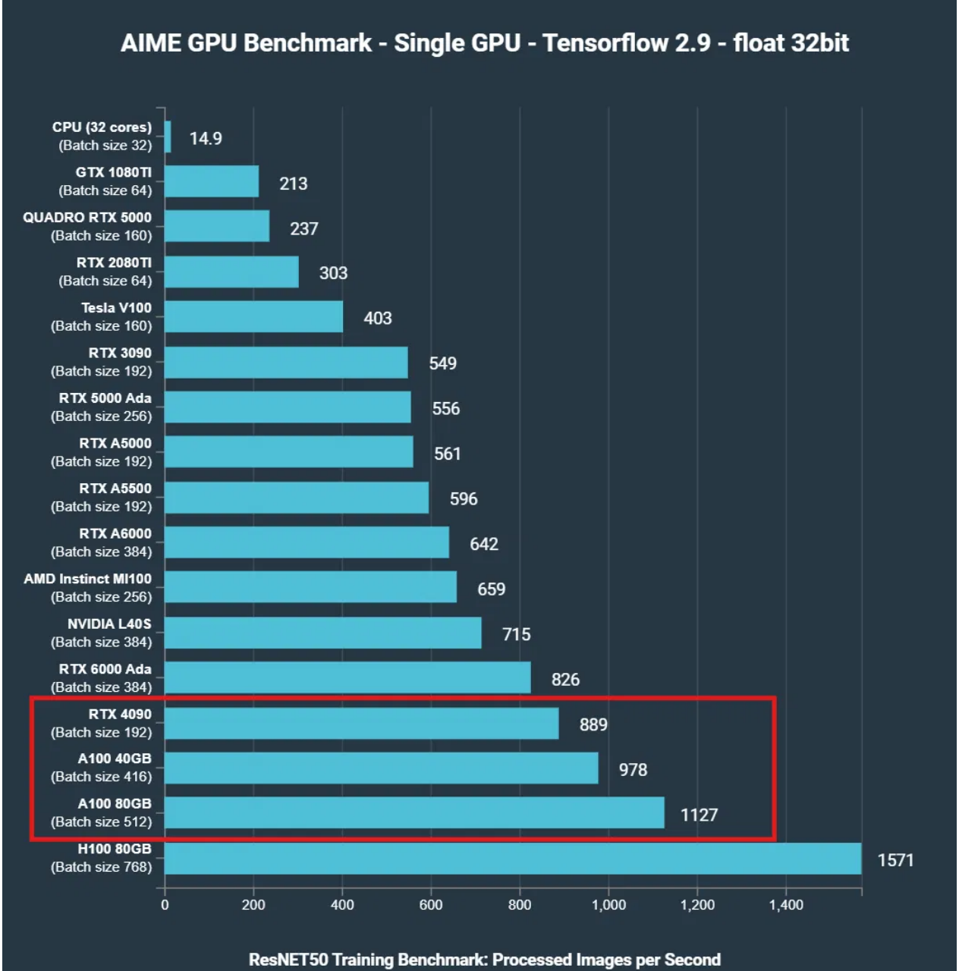
Hardware Platform Analysis
Hardware Performance Heatmap
Key Findings
A100 PCIE: All-Around Champion
Highest energy efficiency across all workloads
High memory bandwidth (1,555 GB/s) advantage
3rd-gen Tensor Core architecture benefits
Ada Lovelace Architecture: Next-Gen Benefits
RTX 4090 shows 20-30% efficiency improvements
4th-gen Tensor Cores excel in mixed precision
Better performance per computational unit
Important Discovery:
New architectures achieve 15-25% efficiency gains per computational unit
Architecture-Specific Insights
Platform
Architecture
Memory BW
Efficiency Gain
Memory Bandwidth Impact:
A100 PCIE
Ampere
1,555 GB/s
Baseline
Critical factor for large model inference
Directly correlates with energy efficiency
RTX 4090
Ada Lovelace
1,008 GB/s
20-30%
Consumer vs. Data Center GPUs:
RTX 4060 Ti
Ada Lovelace
288 GB/s
Best for constraints
Consumer GPUs show surprising efficiency
Cost-performance ratio favors newer architectures
Clear Platform Specialization
High-bandwidth platforms
Power-efficient architectures
High-performance consumer
A100, V100: Computational advantage for complex tasks
RTX 4060 Ti: Optimal for resource-constrained environments
RTX 4090: Ideal balance for research environments
5/10 · Energy-Aware AI Deployment

Slide 6
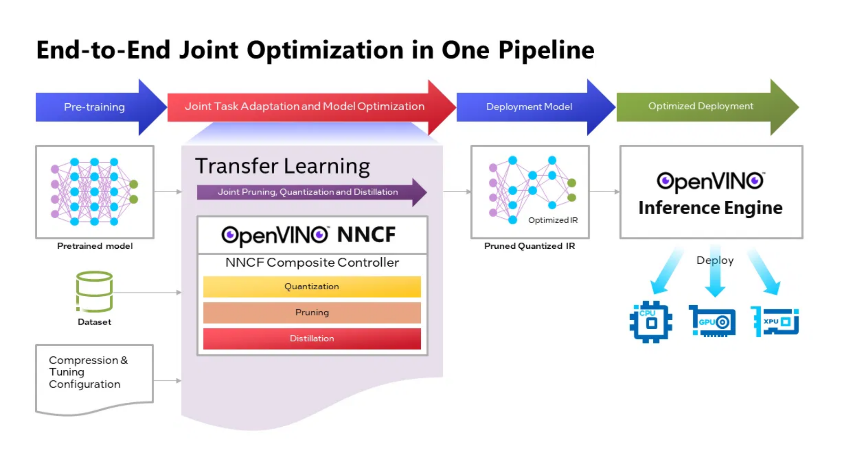
Synergistic Optimization Effect
Synergy Effect Visualization
Key Findings
Strategic Quantization-Hardware Matching:
A100 PCIE + INT8 quantization:
40% comprehensive efficiency improvement
RTX 4090 + FP16 mixed precision:
35% efficiency gain
While maintaining 98%+ baseline accuracy
Knowledge Distillation Enhancement:
DeepSeek-R1-Distill model provides additional 19.8% energy reduction
Cross-platform consistency with enhanced quantization compatibility
EOR and TWEOR Metric Validation:
Successfully capture performance characteristics missed by traditional metrics
Provide quantitative foundation for deployment decisions
A100 + INT8
RTX 4090 + FP16
Knowledge Distillation
Multiplicative vs. Additive Effects
40%
35%
19.8%
Beyond Simple Addition:
Efficiency Improvement
Efficiency Gain
Additional Reduction
Co-optimization yields greater benefits than individual optimizations combined
Hardware-specific quantization tuning unlocks hidden efficiency potential
Core Discovery:
Architectural Compatibility:
Ada Lovelace architecture shows superior INT8 compatibility
Hardware-software co-optimization is the key pathway
to energy-efficient AI deployment
Ampere architecture excels with dynamic quantization
6/10 · Energy-Aware AI Deployment

Slide 7
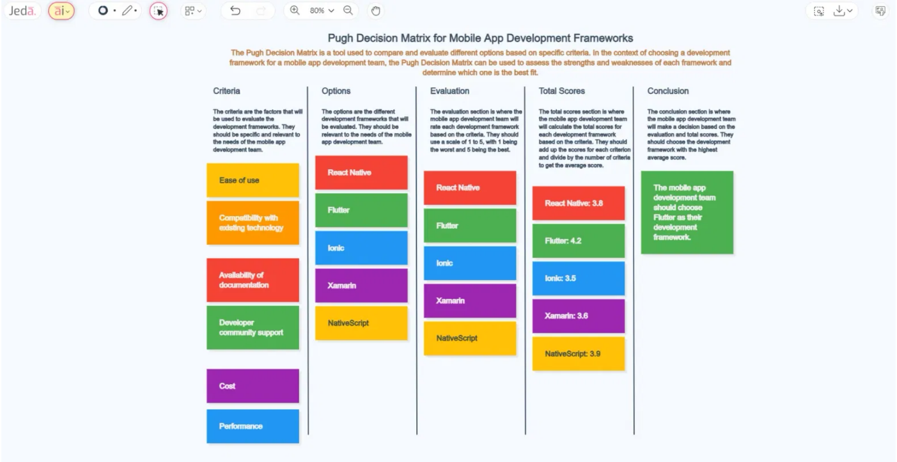
Application Guidelines: Deployment Recommendations
Deployment Decision Matrix
Scenario-Specific Recommendations
Our research demonstrates that different deployment scenarios require different hardware-quantization combinations for optimal energy efficiency. Data center environments benefit from high-performance hardware with aggressive quantization strategies, while edge computing needs solutions that balance power consumption and precision.
By following these recommended configurations, organizations can significantly reduce energy consumption while maintaining model performance, contributing to sustainable AI development.
Data Center Production
Enterprise Applications
Edge Computing Deployment
Hardware:
Hardware:
Hardware:
A100 PCIE
RTX 4090
RTX 4060 Ti
Quantization:
Quantization:
Quantization:
INT8
FP16 mixed precision
Dynamic quantization
Expected:
Expected:
Expected:
98% performance
99% performance
95% performance
40% efficiency improvement
35% efficiency improvement
25% efficiency improvement
7/10 · Energy-Aware AI Deployment

Slide 8
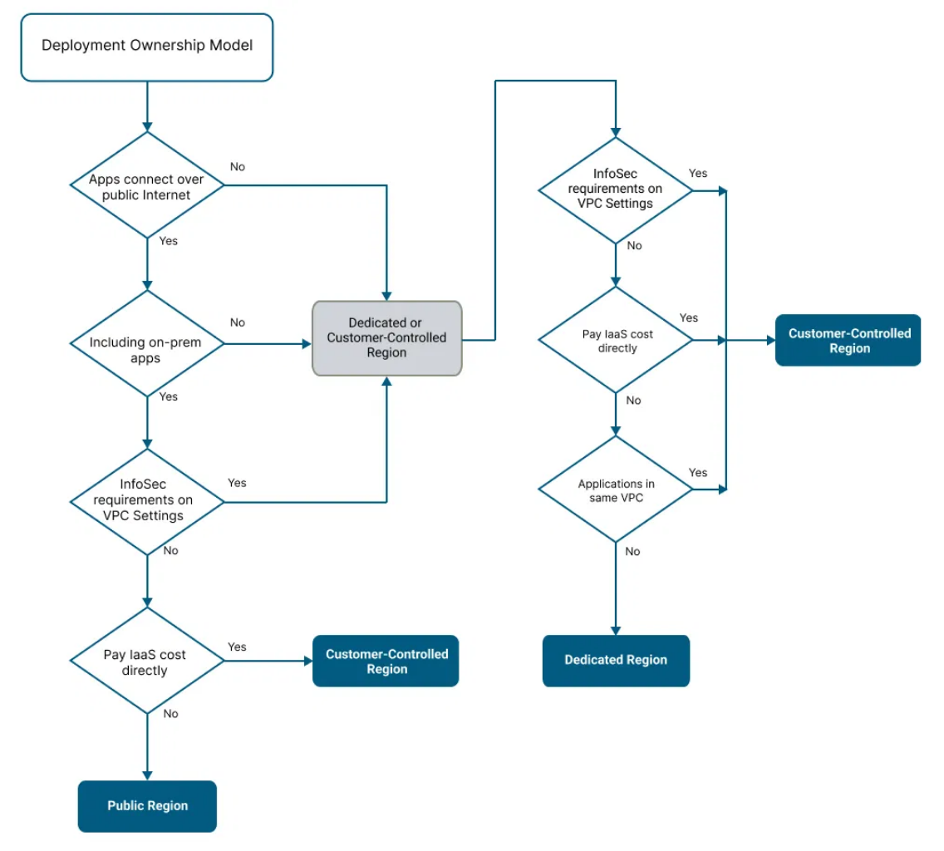



Decision Tree Guidance
Deployment Decision Flow
Decision Framework Value
This decision tree framework provides a systematic approach to help organizations select the optimal hardware-quantization combination based on their specific needs. By following these three key steps, deployment teams can avoid common pitfalls such as over-provisioning hardware or selecting quantization strategies unsuitable for the application scenario.
Our research shows that the right decision flow can achieve 25-40% energy savings while maintaining model performance, which is particularly important for large-scale deployments.
1
2
3
Hardware Support Assessment
Application Requirements Analysis
Cost Constraint Consideration
Evaluate available hardware platforms
Determine precision thresholds
Calculate total cost of ownership
Determine Tensor Core support
Evaluate latency tolerance
Evaluate energy cost impact
Analyze memory bandwidth limits
Analyze input complexity variation
Analyze scale deployment needs
8/10 · Energy-Aware AI Deployment

Slide 9
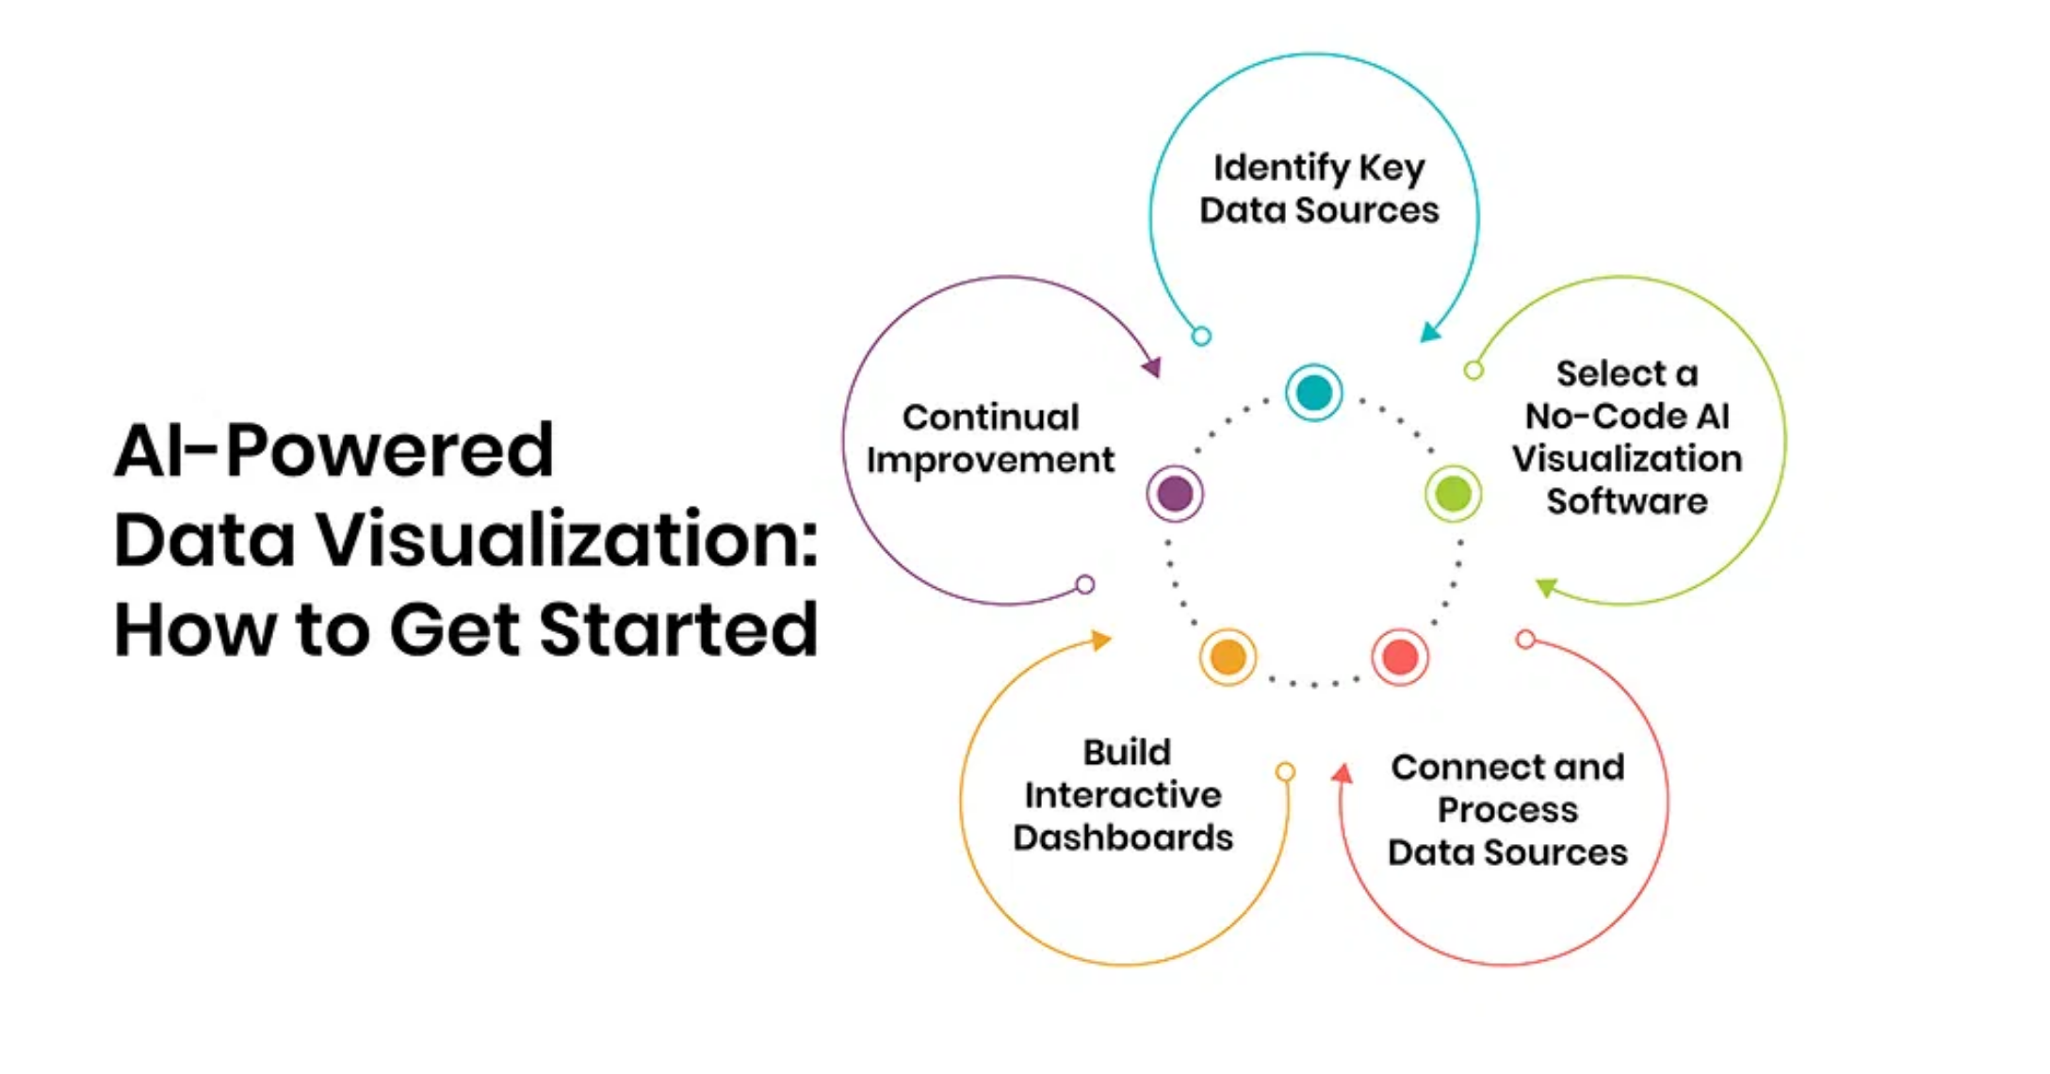


Summary: Core Contributions
Core Contributions Visualization
Technical Contributions
1
First quantization-hardware co-evaluation framework
2
Novel EOR/TWEOR energy efficiency metrics
3
Evidence-driven deployment guidance framework
Quantization Savings
Co-optimization Gain
Accuracy Retention
Real-World Impact
25%
40%
98%+
As AI systems scale deployment,
will become central to sustainable technology development.
energy-aware optimization
Our work provides foundational insights and practical tools for this goal, directly applicable to production environments for significant energy savings.
Key Findings
Quantization techniques can reduce energy consumption by 25%
Co-optimization achieves 40% efficiency improvements
Hardware-software matching is crucial
9/10 · Energy-Aware AI Deployment

Slide 10



Future Work & Acknowledgements
Future Research Directions
Research Impact
Extension to larger model scales
Our work on energy-aware AI deployment provides a foundation for sustainable AI scaling as these systems become increasingly prevalent in society.
Exploring energy efficiency strategies for 70B+ parameter models
The quantization-hardware co-optimization framework offers immediate practical benefits while opening new research directions in energy-efficient AI.
New hardware architecture research
By addressing both technical optimization and deployment guidance, this research bridges the gap between theoretical advances and practical implementation.
Evaluating synergistic effects with next-gen AI accelerators
Real-world deployment scenario validation
Validating findings in diverse production environments
Broader Implications
Energy-efficient AI deployment contributes to corporate sustainability goals and environmental responsibility initiatives.
Cost savings from optimized deployments can be redirected to further research and innovation.
Our framework enables more accessible AI deployment in regions with limited energy infrastructure.
Presenters:
Renyuan Lu, Zinan Wang, Haoji Bian
10/10 · Energy-Aware AI Deployment

